Slide 1
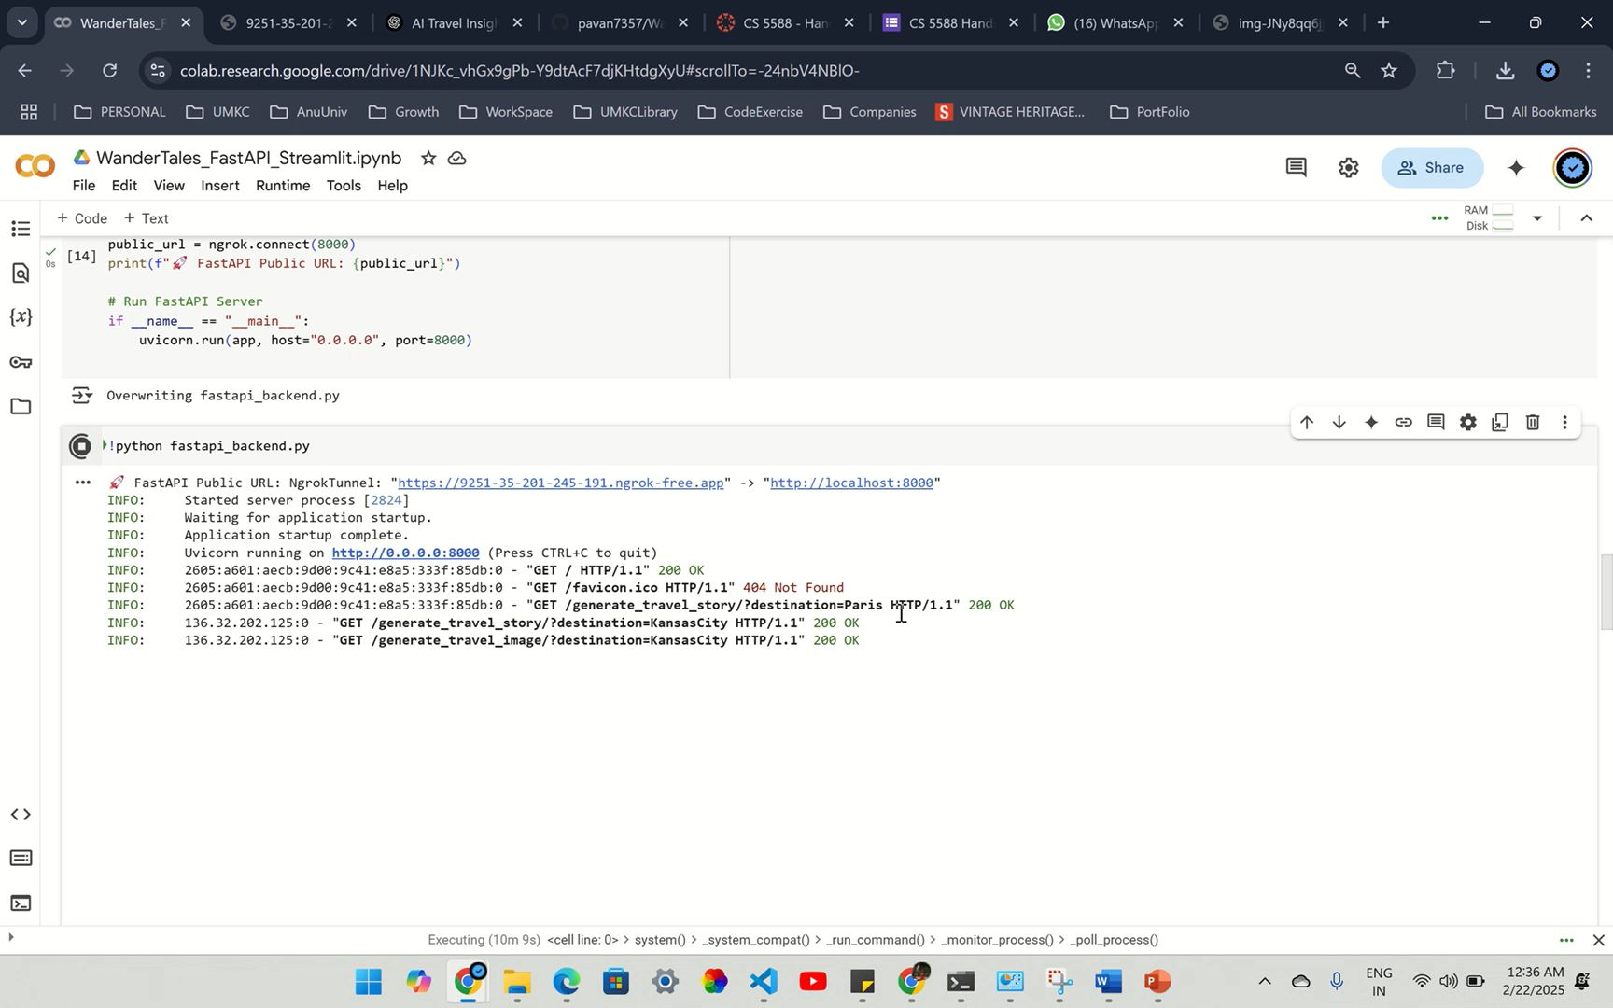
WanderTales FastAPI
Play ⬇️

Slide 2
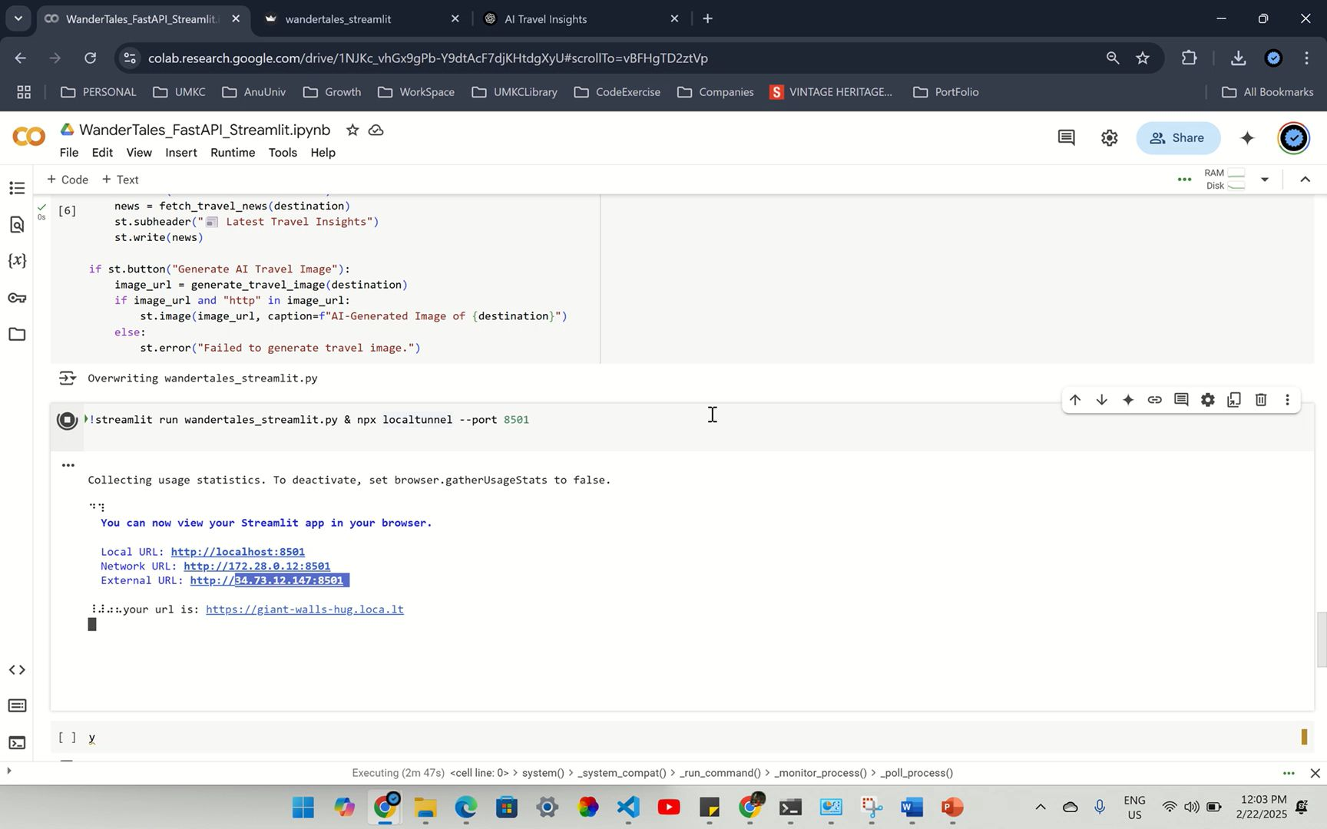
WanderTales_StreamLit
Play ⬇️

